Slide 1


Research proposal on AN INNOVATIVE SMART RAILWAY PLATFORM ASSIST IN DOMESTIC RAILWAY STATIONS
AICTE-SAMRIDDHI
Under the Guidance
Dr. Shivashankar
Professor and Head
Department of Electronics & Communication Engineering,
(Affiliated to VTU, NBA Accredited )
Sri Venkateshwara College of Engineering, Bangalore, India.
Presented by
Ms. Navyashree H A
7th Semester, Department of Electronics & Communication Engineering,
SVCE, Bengaluru, Karnataka, India-562157.
August- 2019

Slide 2
OUTLINE
About SVCE
Motivation of the proposal
Introduction
Research Objectives
Project Overview
Methodology
Outcomes
Scope & Scalability of the proposal
Market analysis
Financial Estimation
Conclusion
References

Slide 3

ABOUT SVCE
http://www.svcengg.edu.in

Slide 4
ABOUT SVCE
Sri Venkateshwara College of Engineering (SVCE), Bengaluru over 19 years has emerged with world class unique learning practices.
Received “GOLD band Rating from the most prestigious INDIAN COLLEGE & UNIVERSITY ranking organization QS-I.GUAGE”
Accredited by National Board of Accreditation (NBA) for the Departments ECE, CSE, MECHANICAL & CIVIL
SVCE has its own Incubation Centre and started new start-up “CRYTONIX SERVICE PRIVATE LTD”.

Slide 5
MOTIVATION OF THE PROPOSAL
The Indian railway system have limitations in providing facilities to the handicapped and elderly aged people for crossing the platforms in the Railway stations.
The aged and disabled commuters feel difficult to take the foot over bridge and reach the other platform.
The other major issue is at Railway gate, where commuters try to cross the gate irrespective of it’s closing.
This condition leads to the loss of several lives especially in our country.

Slide 6
MOTIVATION
Number of Deaths in India due to unauthorized crossing of Rail Platforms in the year 2018-19 (Source: Times of India) | Number of Deaths in India due to unauthorized crossing of Rail Gates in the year 2018-19 (Source: Times of India)
35,690 | 75,256

Slide 7
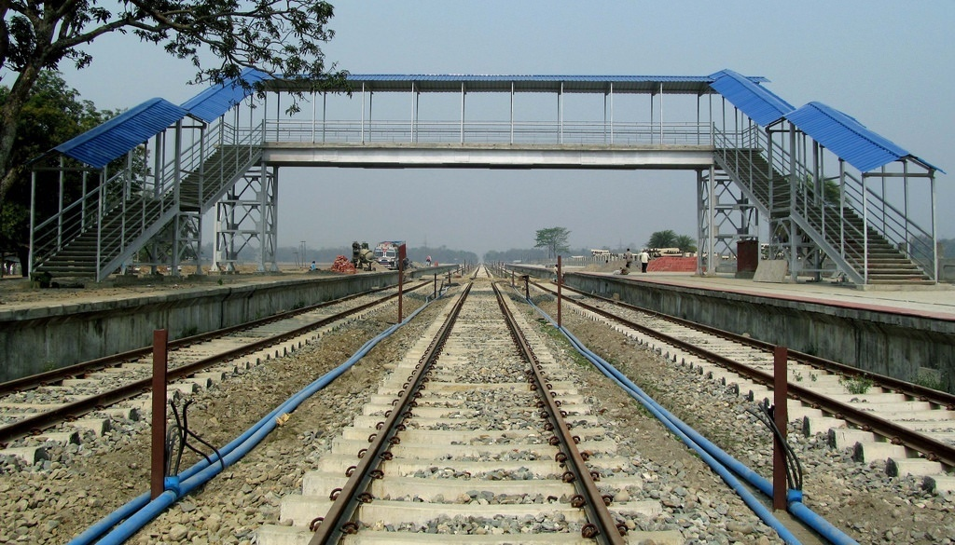

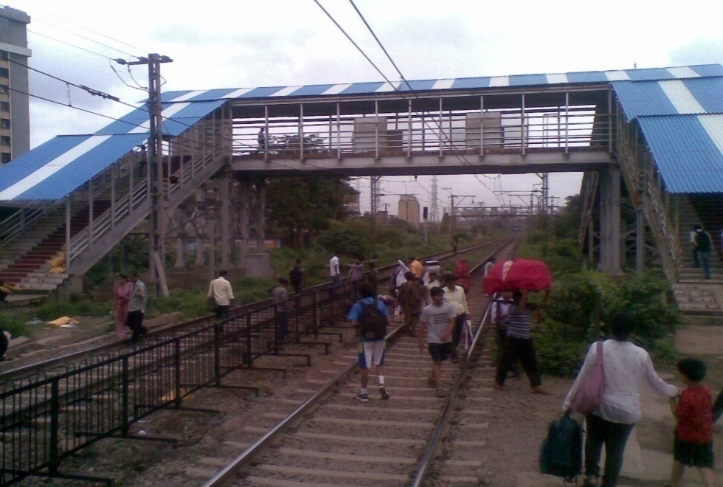
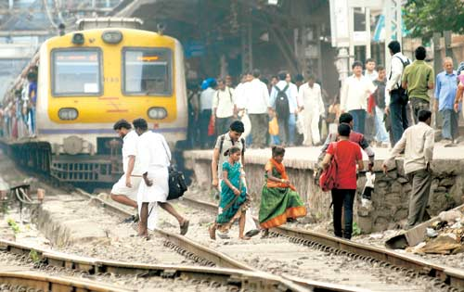
MOTIVATION

Slide 8
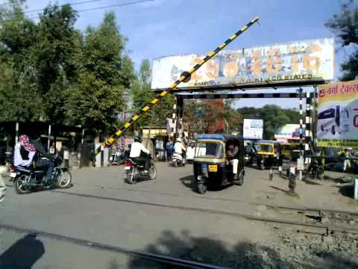
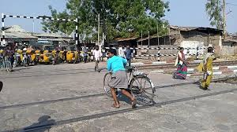
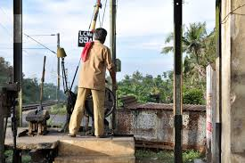
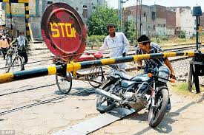
MOTIVATION

Slide 9
INTRODUCTION
Technology always has a vital part in solving several social problems.
Technology based Entrepreneurship venture has lot of scope for job creation in the present day market.
The idea of “An Innovative Smart Railway Platform assist in Domestic Railway Stations” motivated mainly to solve the above mentioned issues happening at the Railway Stations and at Railway gate’s.
The establishment of the start up in this stream always provides the solution for several issues along with the economic development, self empowerment and job creation.

Slide 10
conti..
The first module comes like “Automated Smart Railway platform”, provides service for the needy to cross domestic Railway platform in a very comfortable manner
The second module is the “Automated Railway gate”, blocks the vehicles from crossing the Railway gate during the time when train is approaching.
The smart railway platform integration between the railway platform helps the passengers to cross them.
The smart railway gate helps in avoiding accidents by using the semi-gates which operates automatically without any human intervention.

Slide 11
OBJECTIVES
To design and implement a self initiated smart platform mechanism in Railway stations
To help the physically challenged and aged commuters in crossing the railway platforms.
To avoid railway accidents happening at the railway gates
To establish a Startup in order to materialize this idea for safety and comfort of passengers
To expand the scope of the project through the startup building
To create employment eventually support for the economic growth
To incorporate entrepreneurship culture in the academic institution

Slide 12
PROJECT OVERVIEW (SMART RAILWAY PLATFORM SCHEMATIC)
POWER
SUPPLY
Figure 1: Block Diagram of Smart Railway Platform
MOTOR
PROXIMITY SENSOR
PLATFORM
RAILWAY TRACK
SMART PLATFORM
PLATFORM
RAILWAY TRACK
SMART PLATFORM
CONTROL UNIT
PROXIMITYSENSOR
MOTOR

Slide 13
PROJECT OVERVIEW (SAMRT RAILWAY GATE SCHEMATIC)
METAL
DETECTOR/SENSOR
POWER SUPPLY
METAL
DETECTOR/SENSOR
CONTROL UNIT
MOTOR
STOPPERS
STOPPERS
MOTOR
RAILWAY TRACK
MOTOR
STOPPERS
STOPPERS
MOTOR
Figure 2: Block Diagram of Smart Railway Gate

Slide 14
METHODOLOGY (FIELD SURVEY)
The project implementation starts with the prototype implementation in a field where the system need to be installed.
The survey results to select an optimal field for project installation and execution
The field survey comprises distance measuring distance between the platforms and the selection of a Railway gate
The survey leads to choose the appropriate components and its specifications required for project execution
Devanahalli Railway station in Karnataka has chosen to undergo the entire survey and Installation process, considering the location feasibility

Slide 15
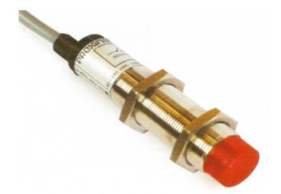
SMART PLATFORM & SMART RAILWAY GATE INSTALLATION
The Installation of Smart Platform involves in setting up of the following sub modules.
Input Unit: It measures/senses the Train information, which is approaching our intended Railway station.
Proximity Sensor: To detect the presence of nearby objects without any physical contact.
Figure 3: Proximity Sensor

Slide 16
Conti.
2. Image processing/Machine Learning Paradigm:
The problem with the proximity sensor /Infrared Sensor is, they are very agile in detecting the objects, means they will detect every object passed across them and triggers the control unit.
To Machine algorithms for detecting the train approach with high accuracy eventually to reduce the errors.

Slide 17
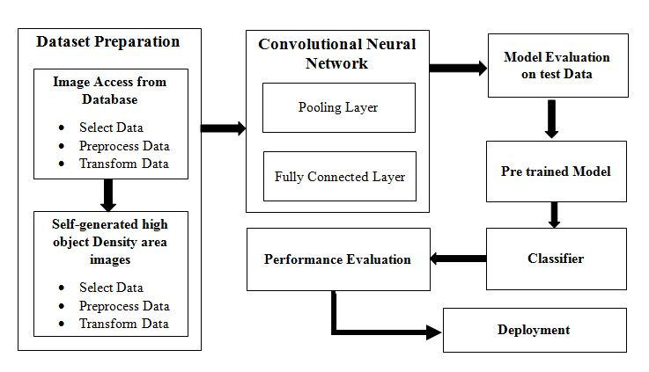
Conti.
Image processing/Machine Learning Paradigm
Figure 5: Learning Model

Slide 18
Conti.
Communication interface
The sensor/image data captured by the input unit need to be processed further upon sending to the control unit.
The wireless mode include GSM, Bluetooth, Zigbee, IoT and Cloud access.
The wireless communication is not feasible considering the factors like internet availability, bandwidth issues, interference problems and line of sight issues for the safety and security for the commuters.
So wired communication is feasible for this project implementation.

Slide 19
Conti.
Processing Unit
The Aurdino UNO is a widely used open-source microcontroller board based on the ATmega328P microcontroller and developed by Arduino.
Motor Unit
The motor unit plays the vital in the whole project, it rotates the plates of the virtual platform based on the control unit commands.
The Motor unit mainly comprises of a AC motor and the AC drivers interfaced through processing unit.
AC drivers decides the direction of Motor rotation and speed control

Slide 20
Conti.
AC Motor Specifications
Driver/Control Unit Specifications
10HP, 1-Phase, 200-240V (Input), IP20 Enclosure, Variable Frequency Drive. Includes ADVANCED DIGITAL KEYPAD
Capacity (Kg) | Rated Speed (m/Sec) | Motor Output (KW) | Capacity of power supply (KVA) | Breaker current rating (A) 400V | Heat emissions (W)
544 | 1.0 | 3.7 | 4 | 15 | 850
 | 1.75 | 6.5 | 6 | 20 | 1340

Slide 21
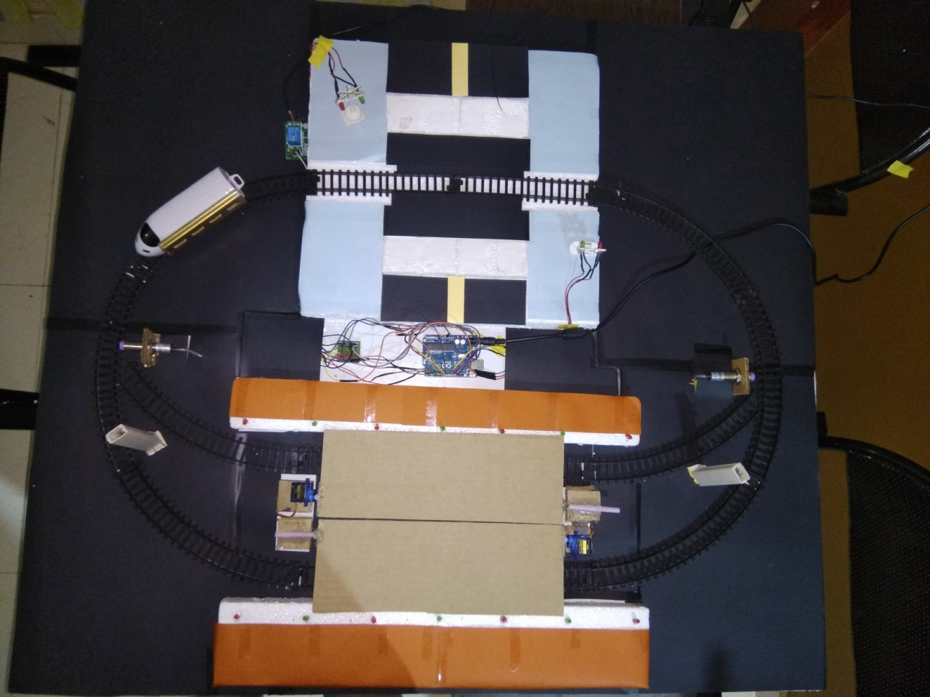
PROTOTYPE IMPLEMENTATION OF SMART RAILWAY PLATFORM

Slide 22
OUTCOMES
Smart Infrastructure development in Railway stations to help physically challenged and old aged people.
Advanced technology add on to current conventional Railway systems.
Self functional Smart railway platform for passengers comfort.
Self functional Smart railway gate mechanism without any human intervention.
Startup initiation for job creation and economic growth
Accidents control at Railway gates.
Private and public sector collaboration for improving the employment.

Slide 23
SCOPE & SCALABILTY OF THE PROJECT
This Project has large scope to be installed in every Railway station across India
Nearly 8500 Railway Stations can avail this add on across India
Nearly 0.5 million lives can be saved every year
World class Infrastructure at every Indian Railway Station
Around 50,000 jobs creation with this start up establishment
Around 1 million students can be motivated

Slide 24
MARKET ANALYSIS
Target Market:
Huge market scope for the project across India and abroad.
Railway Stations and Railway gates are target zones.
Nearly 8500 Railway stations and 179000 Railway gates across India can avail this add on
Outsourcing this service to foreign countries results in financial benefit.
Around 10 million dollar of business scope is estimated with this project every year across India and abroad.
Demand:
Government of India focuses on infrastructure development across the country by 2022.
Nearly 5 trillion dollars are subjected to invest in next 5 years
Always there will be huge demand for cost effective projects like ours in the current scenario of investment and requirement

Slide 25
FINANCIAL ESTIMATION
Estimation for Implementation and Expansion | Amount
1) The cost of purchase of raw materials
a) Materials / Consumables | 5,00,000.00
b) Labor | 55,000.00
c) Travel | 10,000.00
d) Report | 5,000.00
e) Miscellaneous | 25,000.00
2) The cost of contingencies | 35,000.00
3) Maintenance cost | 35,000.00
4) Marketing cost | 80,000.00
5) Start up capacity building | 50,000.00
GRAND TOTAL | 7,95,000.00

Slide 26
CONCLUSION
In conclusion, this project helps the physically handicapped and old aged commuters to cross the railway platforms in a very comfortable manner along with the mitigation of accidents at Railway gates.
This cost effective approach proves to be the best replacement for current day high budget foot over bridges.
This venture ultimately benefits all its stakeholders directly or indirectly in terms of safety enhancement, financial growth, community empowerment, infrastructure update, job creation, industrial revolution and economic growth of the country.

Slide 27
REFERENCES
[1] Arundas M H, Nikhil Babu T S, Lijo K J, “SMART AUTOMATION IN RAILWAY SYSTEM”, IJRET: International Journal of Research in Engineering and Technology, Volume: 04 Special Issue: 03 | August-2016 eISSN: 2319-1163 | pISSN: 2321-7308
[2] SUDARSAN .P, RAM KUMAR. S, SURENDAR. R, UDAY SANKAR. T, KARTHIK. S,“ ARTIFICIAL RAILWAY PLATFORM FOR DOMESTIC RAILWAY STATION”, 21st IRF International Conference, 15th March 2015, Chennai, India,ISBN:978-93-82702-78-8
[3] Prashantha.B.Y, Harisha.S, “ SMART RAILWAY CROSSING EMBEDDED WITH AUTOMATED PLATFORM BRIDGE”, IJRET: International Journal of Research in Engineering and Technology, Volume: 04 Issue: 08 | August-2015, eISSN: 2319-1163 | pISSN: 2321-7308
[4] G.Prabhavathi, B.Sanjana, Ms.S.P.Dhivya, “Railway Track Pedestrian Crossing between Platforms”, IOSR Journal of Electronics and Communication Engineering (IOSR-JECE) e-ISSN: 2278-2834,p- ISSN: 2278-8735.Volume 9, Issue 2, Ver. III (Mar - Apr. 2014), PP 87-91

Slide 28
Thank you

